Slide 1
from Drab to Fab … (… & Whyalla’s best kept secret)
by
Gary Misan, and
Ken Godden

Slide 2
Today’s talk
..a ‘shedder’
our aim…
our history…
our facilities…
what we do…
… and what you can do too!
what we offer…
what’s in it for you…
..the rest

Slide 3
Aim
To promote –
physical health
psychological health
social well-being
By providing –
a male-friendly setting
space for social, craft & other activities
place for –
camaraderie, friendship, fellowship, fun
belonging, purpose, pursuits/interests
community engagement
health promotion & information

Slide 4
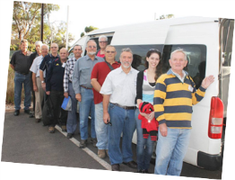
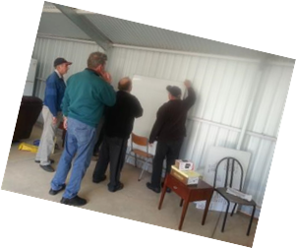
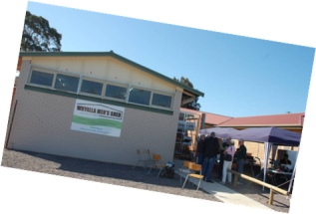
history
2012 - idea first mooted
2013 –
Committee formed
UniSA Partnership – project officer
Incorporated, charity status, ABN, TFN
2 x week at tin shed in Knight Street
2014
secured Holy Trinity Church
cleaning, repair, restoration, planning, building
promotion, grants, fundraising
official opening
2015 – present
going strong & connected to community
multi-purpose space
tools, equipment, amenities
50 members
$ in the bank

Slide 5
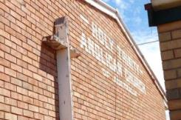
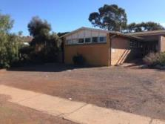
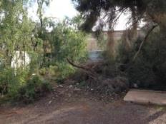
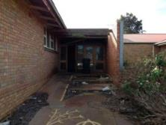
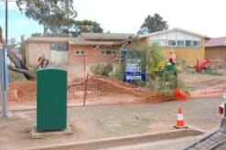
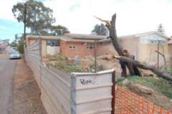
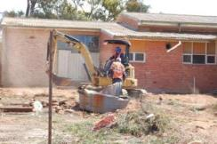
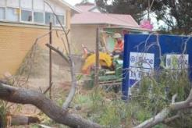
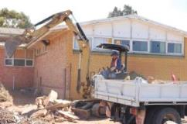
…before - outside

Slide 6
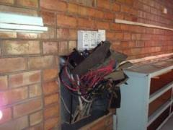
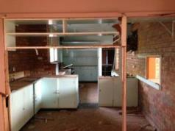
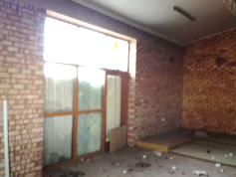
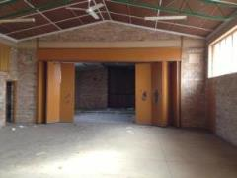
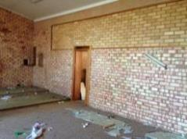
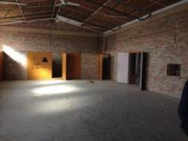
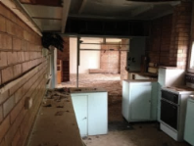
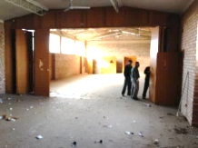
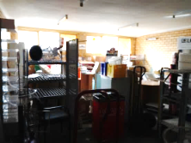
…before - inside

Slide 7
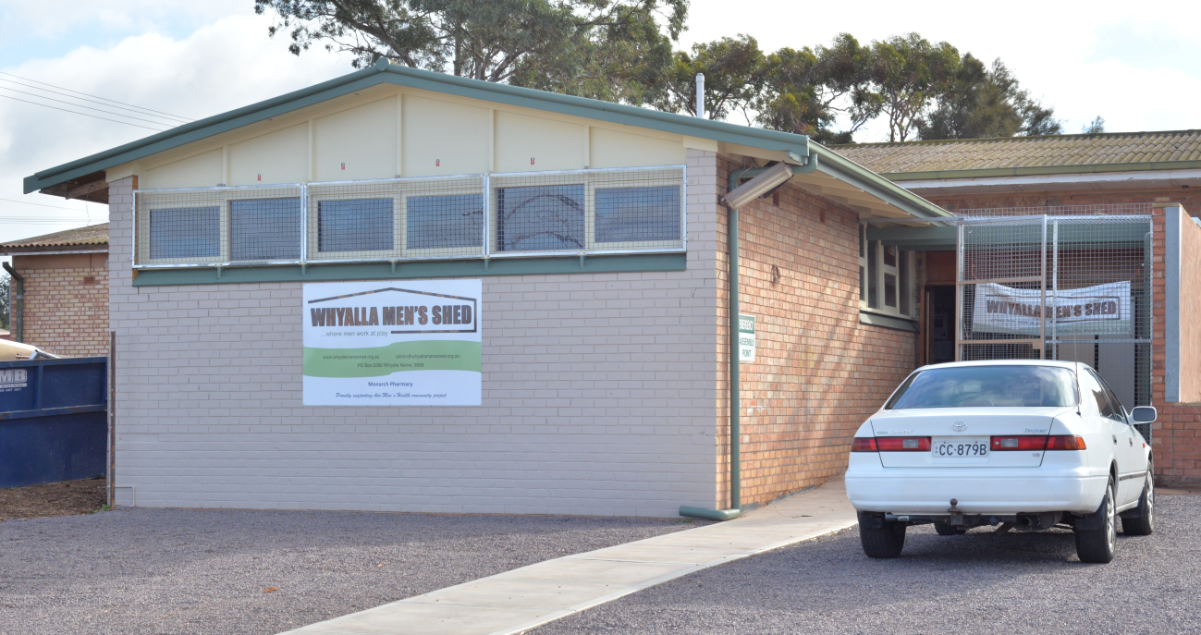
facilities – now
common/crib room
office area
kitchen
wood and metal shop
games room
computer room
outdoor area with BBQ and Pizza oven
outdoor work areas
storage spaces for wood, metal, paint etc.

Slide 8
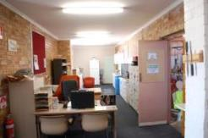
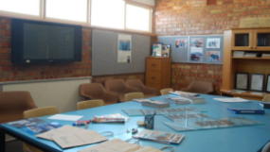
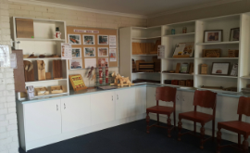
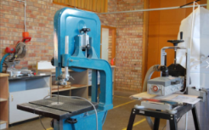
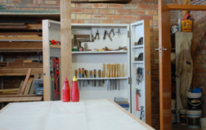
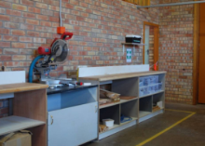
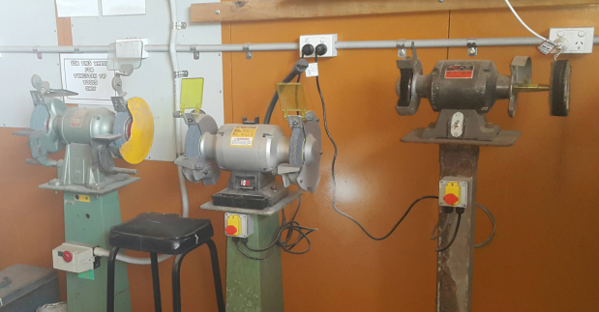
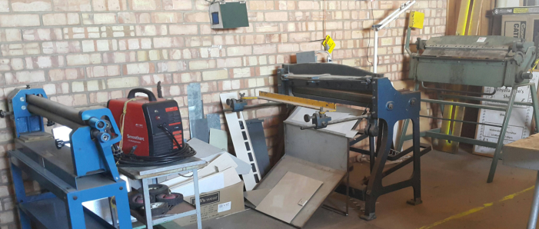
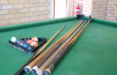
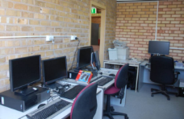
…now - inside

Slide 9
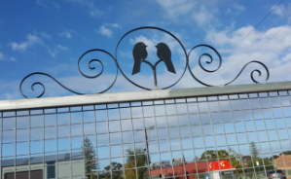
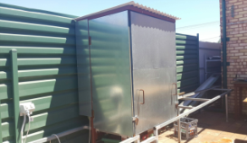
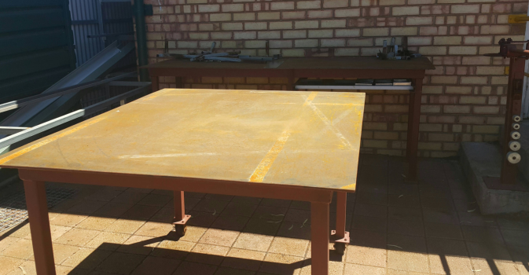
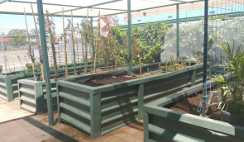
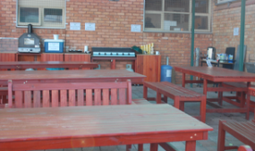
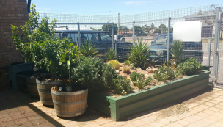
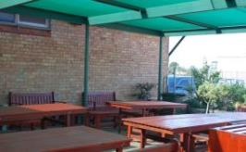
…now - outside

Slide 10
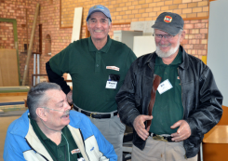
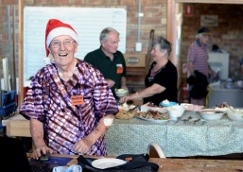
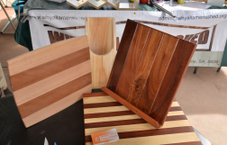
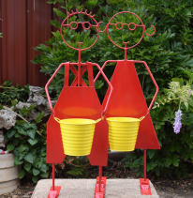
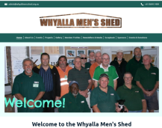
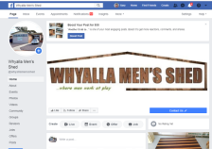
what we do
have fun & socialise
tea/coffee, biscuits, soft drinks
cook & eat
keep busy –
woodwork & metalwork
computing
gardening
TV/movies
board games, cards, pool table
library
books, craft magazines
guest speakers, health promotion activities
social club, Xlotto club
fund raise, attend community events
Web site & Facebook page

Slide 11
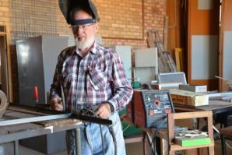
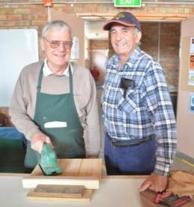
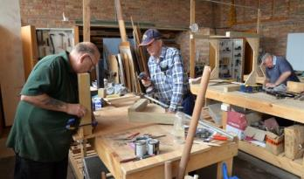
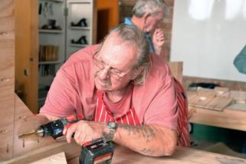
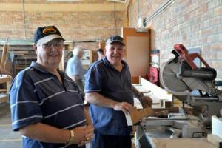
…be as busy as you like…
by yourself or with others

Slide 12
… go from drab to fab …
The raw material
Breaking down the palettes
Machining and planning
Measuring and construction
The finished product

Slide 13
… more fab …

Slide 14
…small things

Slide 15
…more things

Slide 16
…bigger things

Slide 17
…really big things

Slide 18
community services
construction, restoration & repairs in metal and wood
computing –
computers for sale
training/support
saw blade sharpening
other –
mental health clients
work-for-the-dole, centrelink volunteers
university students
assist in community events – school, council etc.

Slide 19
what’s in it for you?
male friendly setting catering for range of interests
good facilities & amenities
improved physical, psychological & social wellbeing
a place to –
have fun & socialise
bond with other males
friendship, fellowship, peer support
share life’s concerns, problems & solutions
keep busy
enjoy physical & mental activity
gain new skills & knowledge
share your knowledge with others including students
renew your sense of identity, belonging & purpose
improve your health literacy
engage with the community thru’ service & events
Fellowship
(of the Ring Shed)

Slide 20
Could this just be … Whyalla’s best kept secret?
open since 2014
a well equipped, multi-function space
friends to meet, social atmosphere & fun to be had
laughs aplenty & things to keep you busy
health & community benefits
… you just need to come along …

